Slide 1
BEST PRACTICES IN EUROPEAN SPORTS COACHING
SOCIAL INCLUSION IN SPORTS
The significance of football in Marseille

Slide 2
We believe access to sport is a
fundamental right for all

Slide 3
NO LANGUAGE BARRIER
MARSEILLE ANSWERS THIS ACTION BY USING THE MOST POPULAR SPORT IN THE WORLD : FOOTBALL
Football is known all over the world. During the 2018 Live Football World Cup Final 1.12 billion people watched.
In every country in the world and there will be children playing football. This is a universal sport that unites humanity.

Slide 4
MARSEILLE HISTORY OF MULTICULTARALISM
Marseille is a melting pot of cultural and ethnic diversity. This is in part due to the historical bonds Marseille has with Italy, Algeria, Comoros and Tunisia.
Pied de page

Slide 5
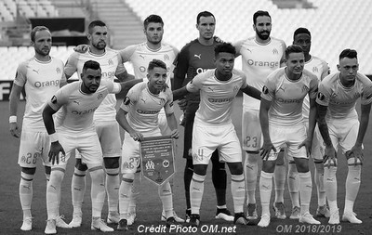
FANATIC ABOUT FOOTBALL
A SHORT INTRODUCTION
Fans of the biggest team in Marseille, Olympique de Marseille (OM) are known for being passionate and dedicated. OM fans (ie. the majority of Marseille) bring the city alive when OM are playing on home turf.

Slide 6
FOOTBALL GALVANIZES PEOPLE TO BE BETTER CITIZENS AND DREAM OF A DIFFERENT LIFE.

Slide 7
CLASS EXERCISE
DIVERSITY IN FOOTBALL
Look at the profiles of the
footballers from Olympique de Marseille. How is the diversity in this team and sport different to other sports you have played?
Think. Pair. Share

Slide 8
INFOS A GOGO

Slide 9
THE ASSOCIATION
Infos a gogo are a Northern Marseille youth charity founded in 1986. They use football to decrease crime and disorder in one of the poorest area’s of Marseille 15th Arrondisement ‘La Maurelette’.

Slide 10
CLASS EXERCISE
YOUTH ENGAGEMENT
Have a look at the Infos A Gogo Facebook page.
How does Infos A Gogo engage young people to get involved with sport and the organization?
Think. Pair. Share

Slide 11
WHAT DOES INFO A GOGO DO?

Slide 12
BUILDING TIES
1. Infos A Gogo uses football to encourage teamwork, good sportsmanship and develops respect between different
neighbourhoods

Slide 13
HOLISTIC FAMIL
Y APPROACH
2. Many of the youth workers previously attended the service themselves. This builds and demonstrates community trust. Families feel safe sending their young people to the club.

Slide 14
INCENTIVES BASE
D APPROACH
3. They encourage volunteering at community events and gardening by providing incentive of a paid for getaway at various locations.

Slide 15
COUNCIL C
ONNECTIONS
4. They also work with local police officers and policy
makers to see what the best practice is in the local area
and also to find out about
the most up to date public funding information.

Slide 16
CRIME AND DISORDER
PREVENTION
5. Infos a Gogo have found that whenever there is a lack of youth and sports provision, crime and
disorder increase in the poorest areas of Marseille. The rate of
death by dangerous driving also considerably increases.

Slide 17
CLASS EXERCISE
YOUTH ENGAGEMENT
Why do you think the main reasons crime and disorder go up when there is a lack of youth and sports provision?
Think. Pair. Share.

Slide 18
BEST PRACTICES IN EUROPEAN SPORTS COACHING
An Erasmus+ supported project

