Slide 1
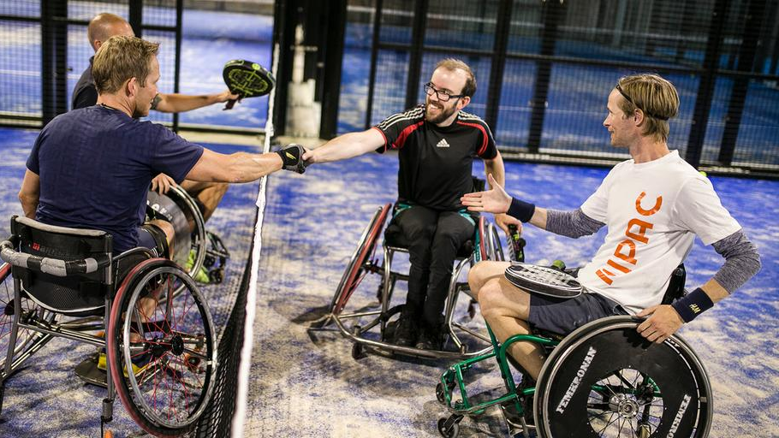
BEST PRACTICES IN EUROPEAN SPORTS COACHING.
ACCESSIBILITY IN SPORTS COACHING

Slide 2
WHAT IS ACCESSIBILITY?
The opportunity for people to participate in the sports of their choice, even if they have:
A physical or mental disability or impairment
Limited means
Accessibility means people are:
Empowered
More independent
Not frustrated by poor design or implementation

Slide 3
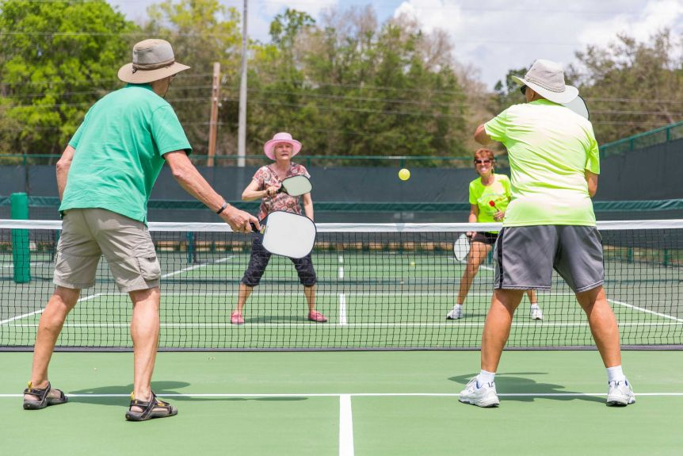
BARRIERS TO ACCESSIBILITY
Lack of early experiences
Lack of understanding and awareness of how to include people with a disability
Limited opportunities and programmes
Inaccessible facilities
Attitudes towards disabilities
Limited access to information and resources

Slide 4
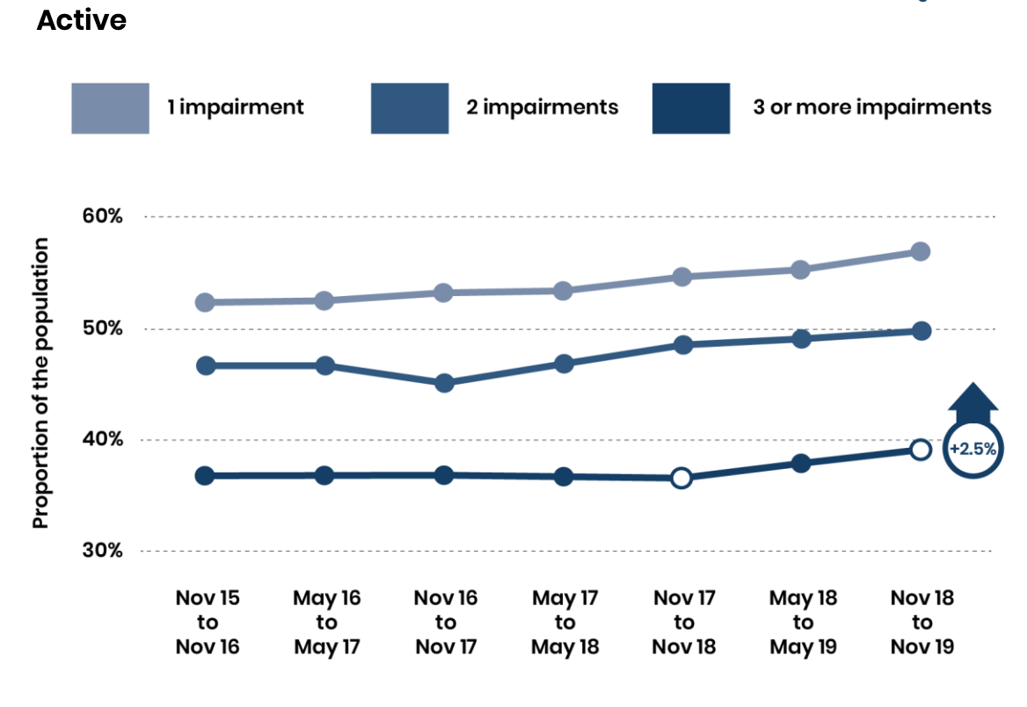
DEMAND FOR OPPORTUNITIES
Disabled or not, there is a significant demand for more opportunities to take part in sport.
According to the Active People Survey, 56% of disabled people in the UK would like to do more sports (2014/2015)
The graph does show activity levels rising amongst people with disabilities over the last few years.
However, people without a form of disability are around 20% more active each week. This gap can be reduced with more opportunities.
Pied de page

Slide 5
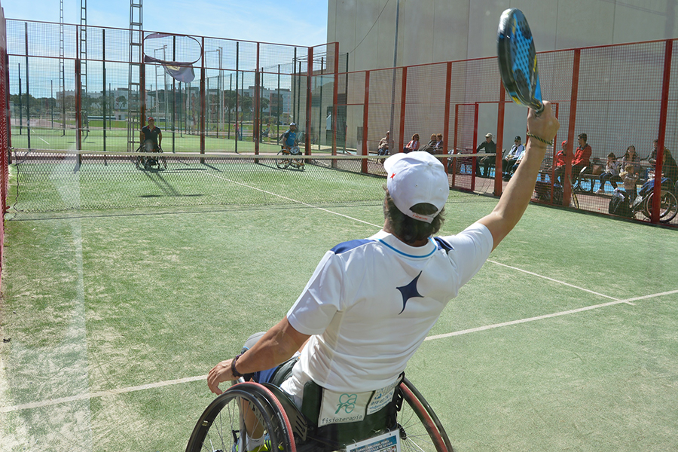
Make your coaching, sport and club more accessible to all.
There is demand for opportunities!

Slide 6
CREATING OPPORTUNITIES
Improve facilities of the club or centre
Consider offering affordable and free services
Increase staff awareness and understanding through courses and workshops on inclusion
Diversify your programmes and activities to appeal to and involve more people
Adapt your coaching techniques and activities

Slide 7
PÁDEL
A SHORT INTRODUCTION
Pádel combines elements of tennis, badminton and squash
It’s a four player game, played in doubles, with courts that are around half the size of a tennis court
The court is surrounded by glass walls, which can be used to bounce the ball off
With over 10 million players worldwide, pádel is one of the fastest growing sports in the world

Slide 8
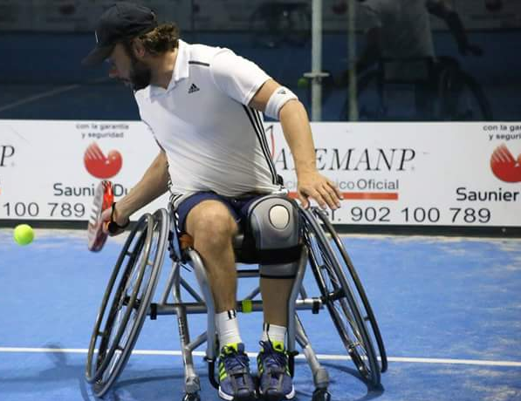
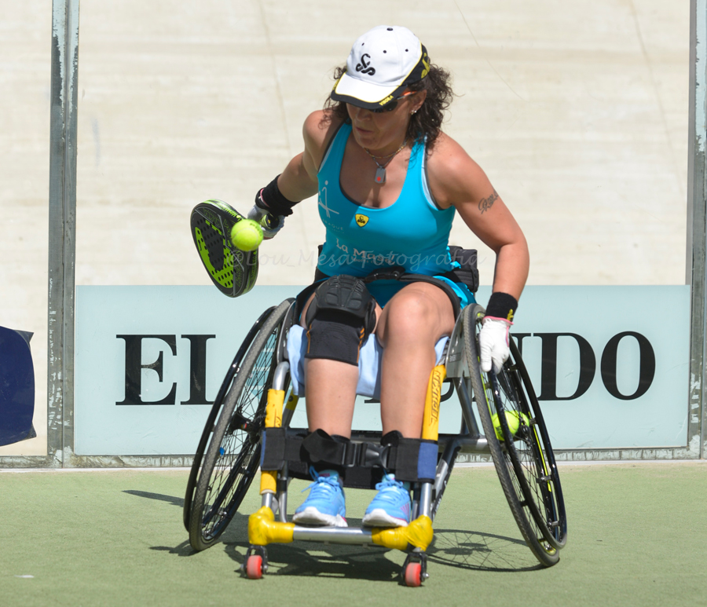
PÁDEL FOR ALL
Pádel is popular among people with physical disabilities and learning disabilities.
It’s a sport that can be easily adapted.
The Pádel Association for All (ASPADO) and Integrated Pádel Association (API) organise many tournaments for disabled people in Spain
Pied de page

Slide 9
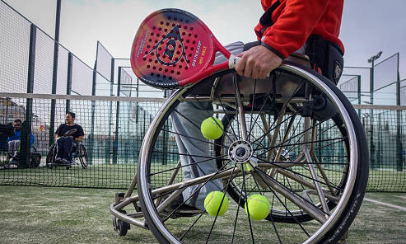
Adapted
Pádel
The rules remain the same but there are some key differences to make the game more fluid and assist players:
The ball can make two bounces instead of one.
A player having difficulty using their hand in the serve can bounce the ball first on their paddle.
The height of the serve is below the shoulder. In original pádel, it is below the waist.

Slide 10
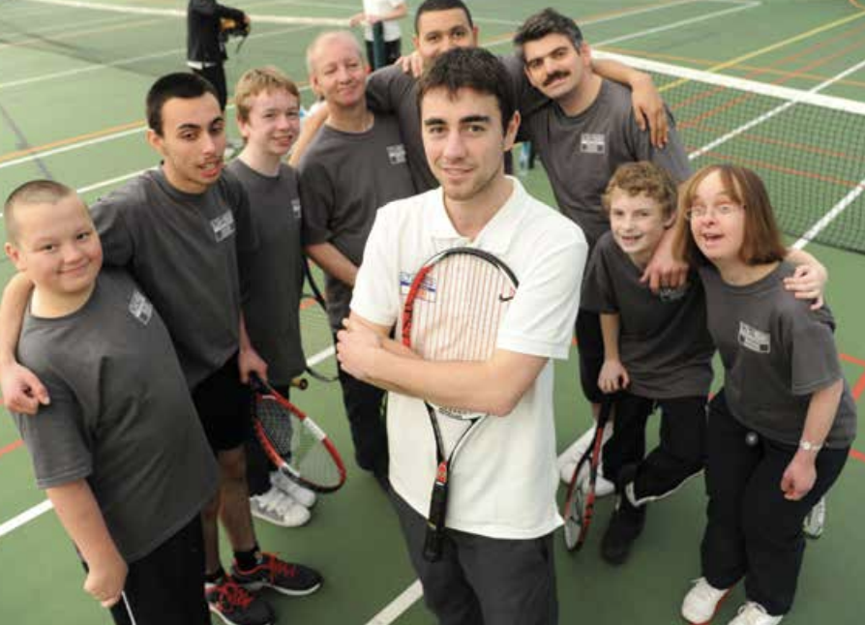
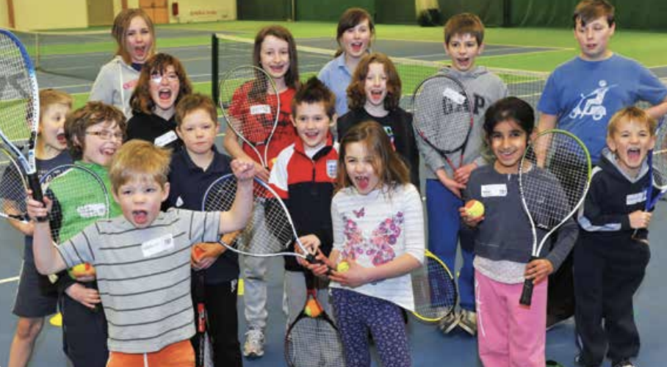
TENNIS FOUNDATION
Advice on disability coaching:
Change size of play area or scoring method
Use non-verbal communication
Adapt equipment, such as using softer, larger balls, bright colours, shorter rackets
Education through courses, workshops and qualifications

Slide 11
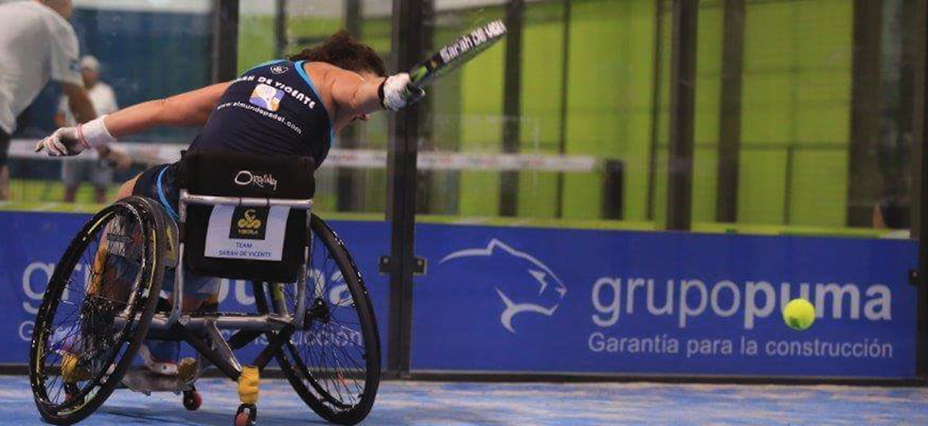
CLASS EXERCISE
ADAPT YOUR COACHING
In what ways can you adapt your own sport and coaching activities to improve accessibility?
Consider barriers to accessibility and adaptations that have been discussed so far.

Slide 12
”You do not need to be a young, great athlete to excel at the game.
This clearly shows that: Padél is a more a Game of Will than Skill."
John Milbank, professional pádel player

Slide 13
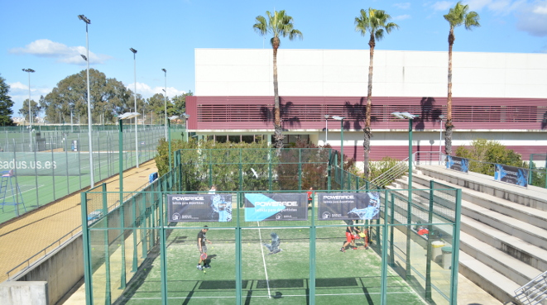
CLASS EXERCISE
HOW ACCESSIBLE IS YOUR CLUB?
Time to assess your own club or sports centre!
Move around in pairs and note down things that could assist or reduce accessibility.
How could your club improve?

Slide 14
BEST PRACTICES IN EUROPEAN SPORTS COACHING
An Erasmus+ supported project

